Slide 1
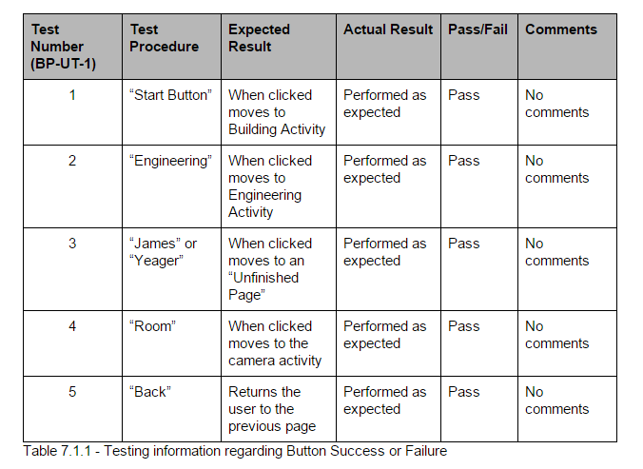
Deliverable 7 testing
Buttons Testing

Slide 2
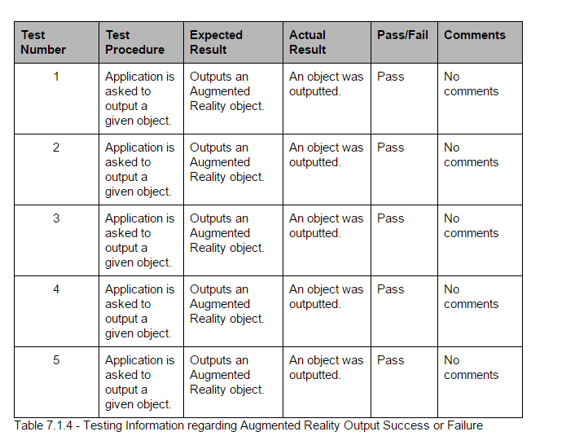
Image Recognition from Unity works
Detailed Budget

Slide 3
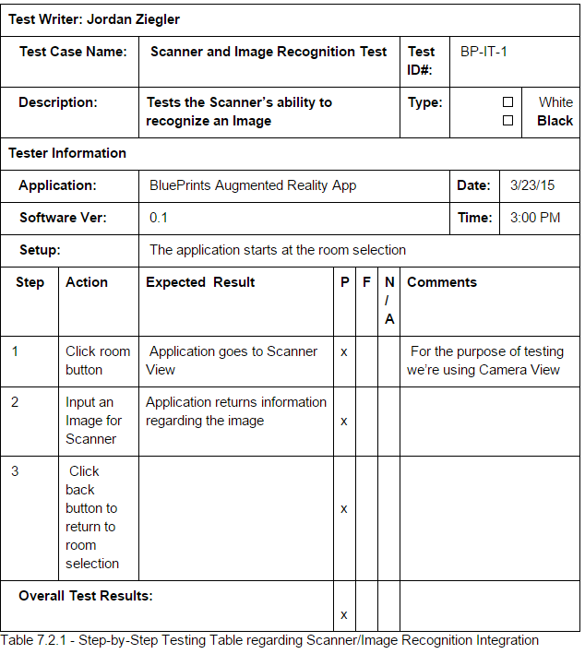
Integrated testing involving unity
Integrated testing getting the unity application to return an output based on an image
Detailed Budget

Slide 4
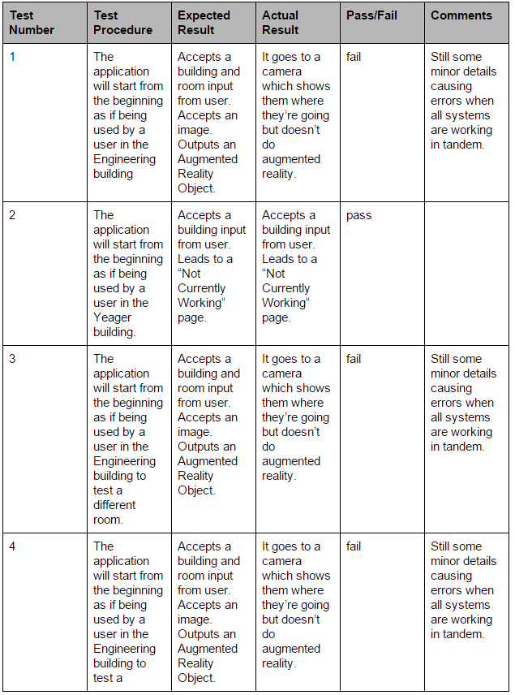
System Testing
Detailed Budget

Slide 5
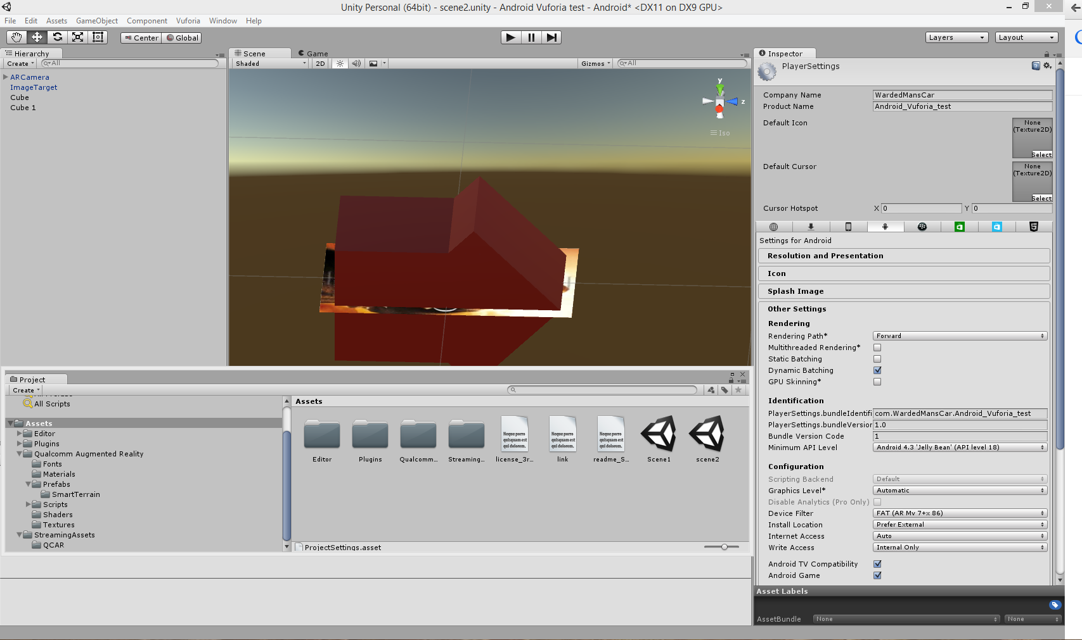
Unity Screenshot

